Slide 1
AGG net
Ajou Univ. software dep. 201920723 김동욱
Kim Dong Wook

Slide 2
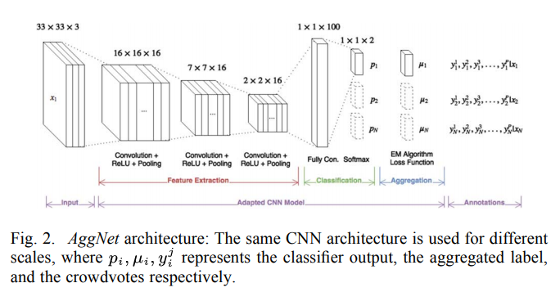
model
AggNet
-CNN with Aggregation Layer, used crowdsourcing
-noise-resistant
-Detection in Breast Cancer

Slide 3
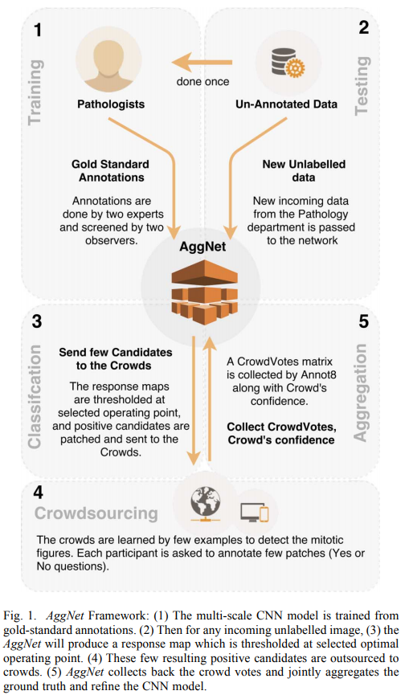
training
1. Train multi-scale CNN with data labeled by pathologists.
2. Choose good response maps and send them to crowds.
3. Get back the crowd annotations and refine the model

Slide 4

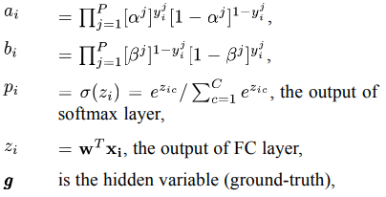

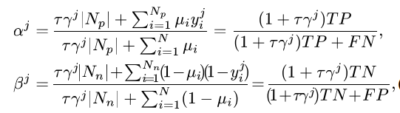

loss

Slide 5
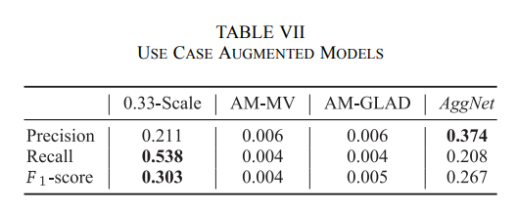
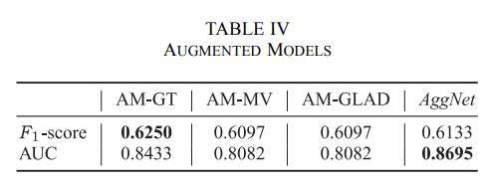
conclusion

Slide 6
paper
AggNet : https://ieeexplore.ieee.org/document/7405343

Slide 7
note
Aggnet : multi-scale CNN with Aggregate layer.
It uses crowdsourced data(noisy).
Aggregate layer uses cross entropy with specificity and sensitivity for loss.
The result wasn’t that bad but multi-scale CNN(without AGG layer) was better(because of crowd source).

Slide 8
keywords
Aggregate layer
Crowd sourcing

